Slide 1

Management System

Slide 2
Introduction to Hudumia Health
Overview
Hudumia Health is an innovative digital healthcare management system designed to streamline patient care across various health programs, including TB, HIV, and Malaria. This system revolutionizes how healthcare providers manage patient information and program data.
Purpose
Efficiency: Hudumia Health aims to eliminate the inefficiencies of traditional paper files and scattered spreadsheets.
Accessibility: It provides a secure and user-friendly platform for healthcare providers to enhance patient care.

Slide 3
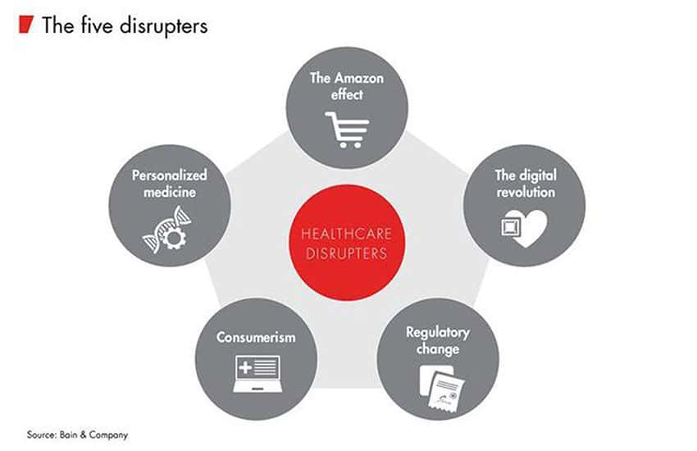
The Need for Digital Healthcare Management
Challenges of Traditional Systems: Healthcare providers often face significant challenges when relying on traditional methods for patient management.
Paper Files: Prone to loss, damage, and misfiling, leading to inefficiencies in patient care.
Scattered Spreadsheets: Difficult to manage and update, resulting in fragmented patient information.
The Call for Change:
Need for Efficiency: A more streamlined and organized approach is essential for effective healthcare delivery.
Digital Solutions: The healthcare industry requires innovative digital solutions to improve patient management and care.

Slide 4
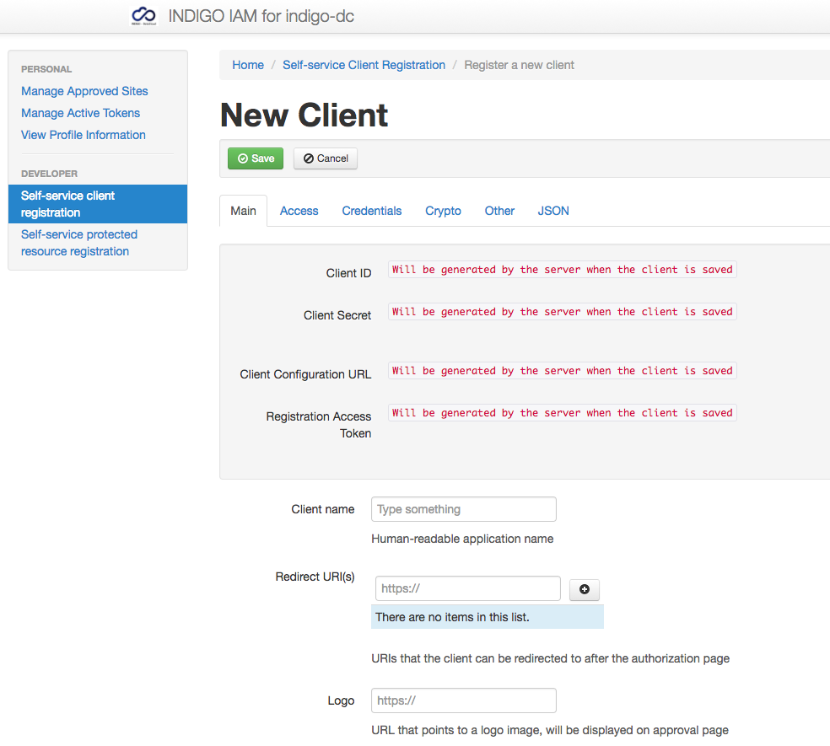
Transforming Healthcare Management
Digitization of Client Registration: Hudumia Health transforms healthcare management by digitizing the client registration process.
No More Paper Forms: Doctors can register clients electronically, reducing paperwork and errors.
Centralized Data: All client and program data is stored in one easy-to-use platform, enhancing accessibility.
Benefits:
Improved Workflow: Streamlined processes allow healthcare providers to focus more on patient care.
Enhanced Data Management: Centralized data facilitates better tracking and reporting of patient progress.

Slide 5
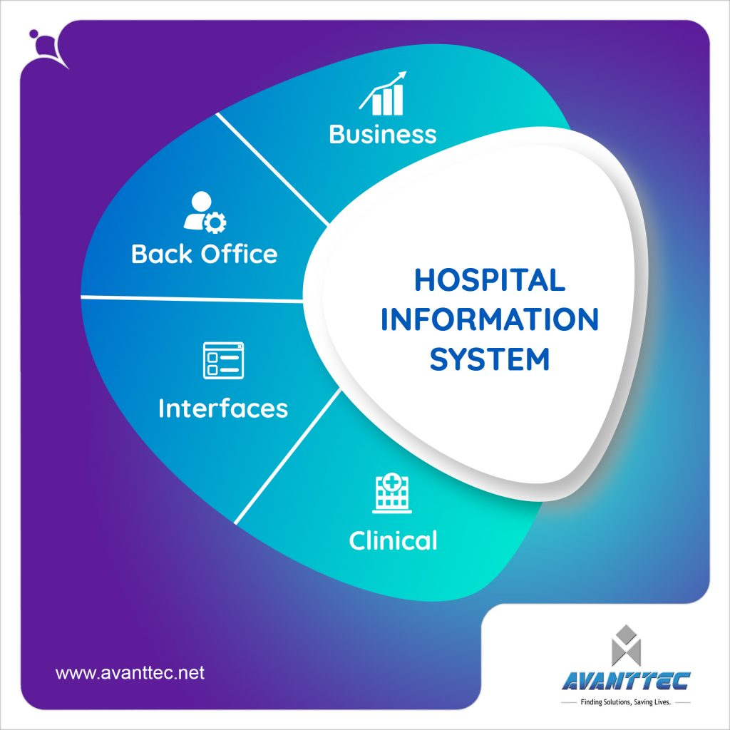
Key Features of Hudumia Health
Core Features: Hudumia Health offers a range of core features designed to enhance healthcare management.
User-Friendly Interface: Intuitive design makes it easy for healthcare providers to navigate the system.
Comprehensive Capabilities: Supports various health programs, ensuring flexibility and adaptability.
Additional Features:
Doctor Authentication: Secure sign-up, login, and logout processes with password hashing.
Two-Factor Authentication (2FA): Optional security feature via Google Authenticator for added protection.

Slide 6
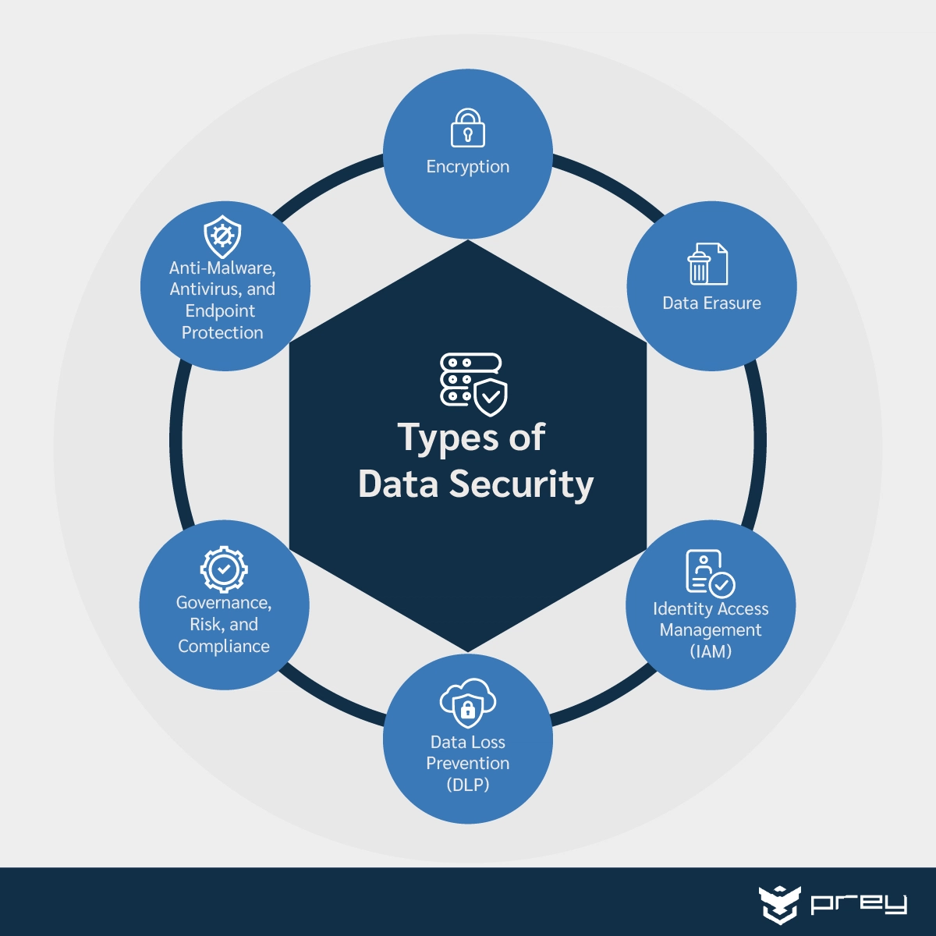
Doctor Authentication and Security
Security Measures: Hudumia Health prioritizes the security of patient and doctor data through robust authentication measures.
Secure Password Hashing: Protects user credentials from unauthorized access.
Optional 2FA: Adds an extra layer of security, ensuring that only authorized users can access sensitive information.
Importance of Security:
Data Protection: Safeguards patient information against breaches and unauthorized access.
Trust: Builds confidence among healthcare providers and patients in the system's reliability.

Slide 7
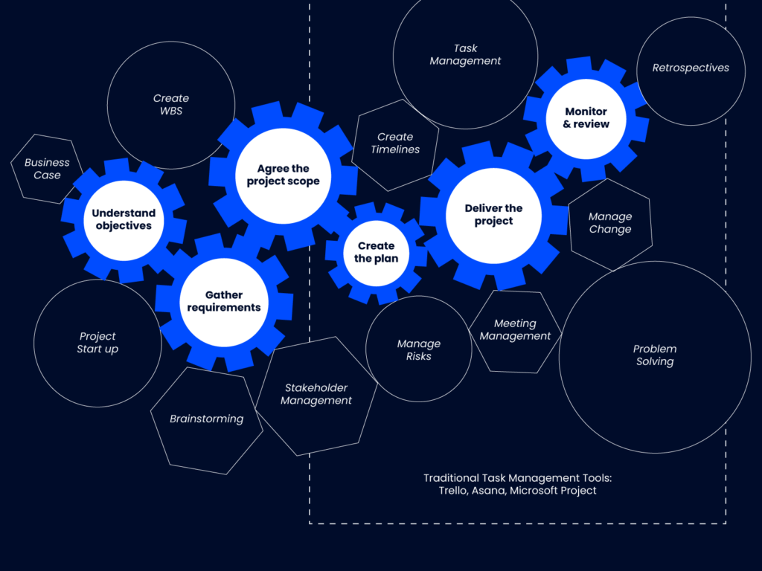
Program Management Capabilities
Enhanced Program Management: Hudumia Health provides comprehensive program management features for healthcare providers.
Create, Edit, and Delete Programs: Doctors can easily manage health programs such as TB and HIV initiatives.
Multi-Program Management: Simplifies the process of overseeing multiple health programs simultaneously.
Benefits:
Flexibility: Allows healthcare providers to adapt programs based on patient needs and emerging health trends.
Efficiency: Streamlined management reduces administrative burdens, enabling more focus on patient care.

Slide 8

Simplifying Client Management
Seamless Client Management: Hudumia Health simplifies the client management process for healthcare providers.
Client Registration: Doctors can register clients quickly and efficiently.
Program Enrollment: Easy enrollment in health programs, with the ability to update client progress seamlessly.
Advantages:
Time-Saving: Reduces the time spent on administrative tasks, allowing more time for patient interaction.
Improved Tracking: Facilitates better monitoring of client progress and program effectiveness.

Slide 9
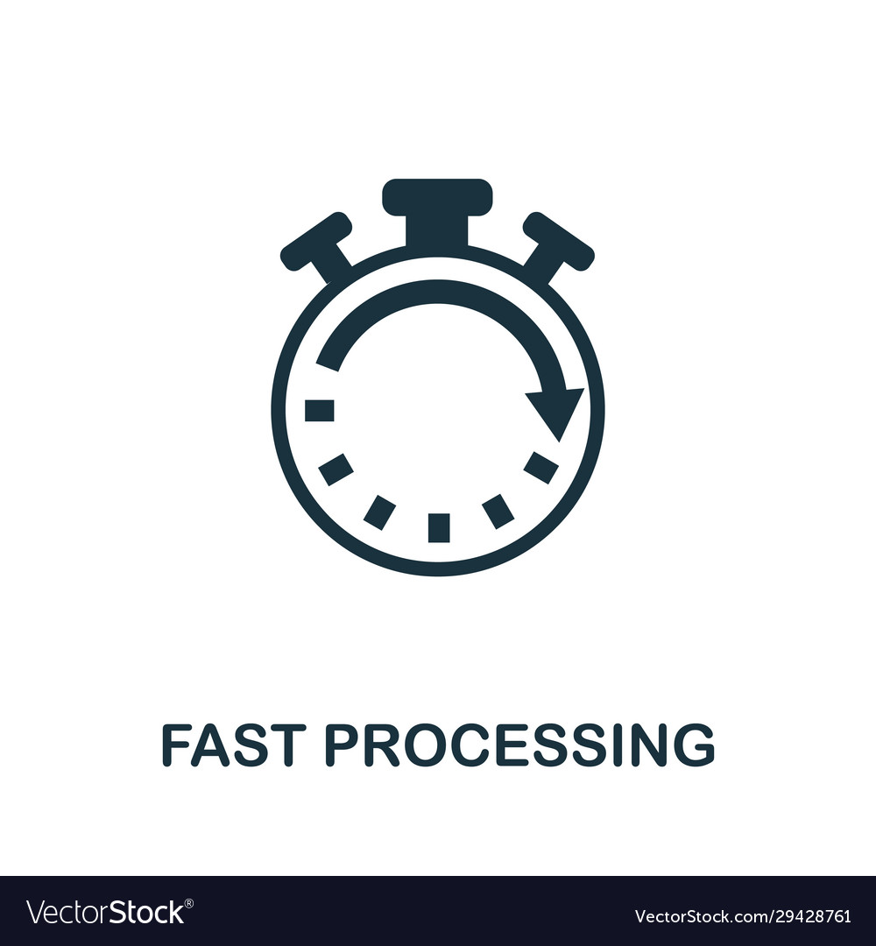
Speeding Up Enrollment and Reporting
Benefits of Faster Processes: Hudumia Health significantly speeds up client enrollment and program reporting.
Quick Enrollment: Streamlined processes enable rapid client registration and program assignment.
Efficient Reporting: Automated reporting features reduce the time spent on paperwork.
Focus on Patient Care:
More Time for Care: Healthcare providers can dedicate more time to patient care rather than administrative tasks.
Enhanced Patient Outcomes: Improved efficiency leads to better health outcomes for clients.

Slide 10

Accountability in Healthcare
Promoting Accountability: Hudumia Health fosters accountability through traceable records for every client and program enrollment.
Traceable Records: Every action taken within the system is logged, ensuring transparency.
Program Enrollment Tracking: Allows healthcare providers to monitor client participation and progress effectively.
Importance of Accountability:
Transparency: Builds trust between healthcare providers and patients.
Quality Assurance: Ensures that healthcare programs are being implemented effectively and responsibly.

Slide 11

Conclusion: The Future of Healthcare with Hudumia H
Vision for the Future: Hudumia Health represents a significant advancement in healthcare management, paving the way for a more efficient and effective healthcare system.
Positive Impact: The system enhances patient care and streamlines healthcare processes.
Innovative Solutions: Emphasizes the importance of digital solutions in modern healthcare.
Call to Action: As we look to the future, embracing innovative systems like Hudumia Health will be crucial in transforming healthcare management and improving patient outcomes across the globe. By creating a Mobile app version and integrating SMS and Email Reminders for enrolled clients. We will make overall experience better for our users

